Slide 1
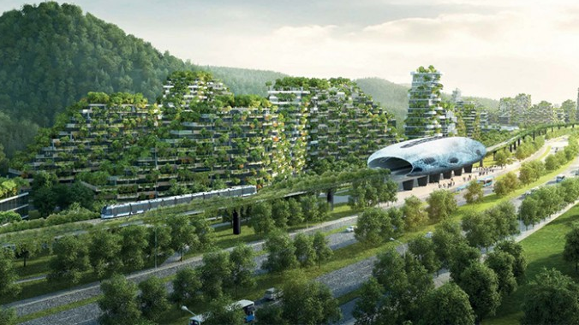
Rethinking the Urban-Rural Relationship: Toward an Ecological Civilization
Wm. Andrew Schwartz, PhD Co-Founder & Executive Vice President Institute for Ecological Civilization

Slide 2
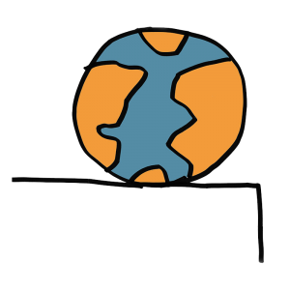
Vision for Vermont 2050: Where Are We Going?
Is it possible for humans to live in a sustainable and equitable way on this planet? What would that look like? How would our communities be organized? What fundamental changes to our societies systems and structures, values and worldviews, are needed to achieve lasting results?

Slide 3
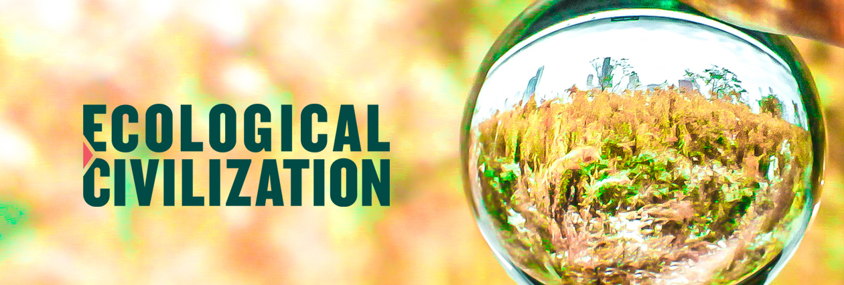
The Institute for Ecological Civilization (EcoCiv) is a group of environmental philosophers, systems thinkers, and facilitators that convenes leaders like you to work toward systemic solutions to our complex social-environmental crisis by clarifying a shared vision, working backward from that vision to our present, and identifying a way forward toward that vision.
Transitioning to a new civilization involves a paradigm shift of our societies systems and structures. As such, we agree with Bill McBibben who recently noted that “philosophy is as essential as engineering for successfully maneuvering through the obstacle course that is our immediate future.”

Slide 4
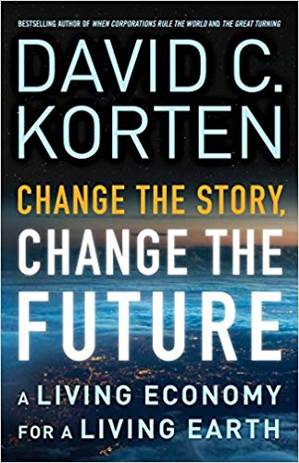
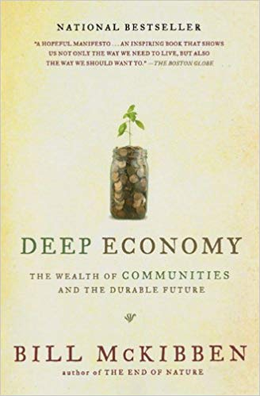
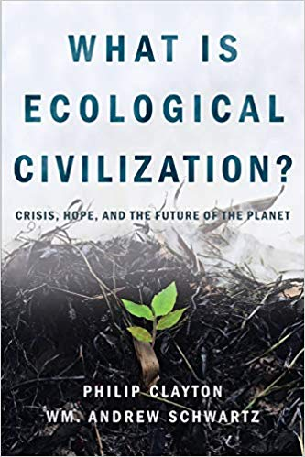
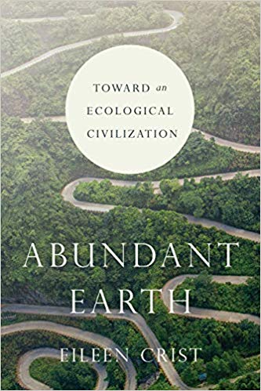
What Do We Mean By Ecological Civilization?
“It is a vision for a radically different future in which the systems of society—economics and politics, systems of production, consumption, and agriculture—are redesigned in light of planetary limits. The vision emerges from the death of the modern expand, conquer, and consume mentality and tells a new story of harmony with a living Earth: contract, cooperate, and cultivate.”

Slide 5
Addressing Root Causes Not Symptoms: What’s The Problem Beneath the Problem?
“The crucial idea behind an ecological civilization is that our society needs to change at a level far deeper than most people realize. It’s not just a matter of investing in renewables, eating less meat, and driving an electric car. The intrinsic framework of our global social and economic organization needs to be transformed” (Jeremy Lent, “We Need an Ecological Civilization Before It’s Too Late”)
Rather than focusing on regenerative agriculture, ecological economics, and other specific practices this event is an opportunity for you to talk about the paradigm necessary to achieve your goals for Vermont 2050.

Slide 6
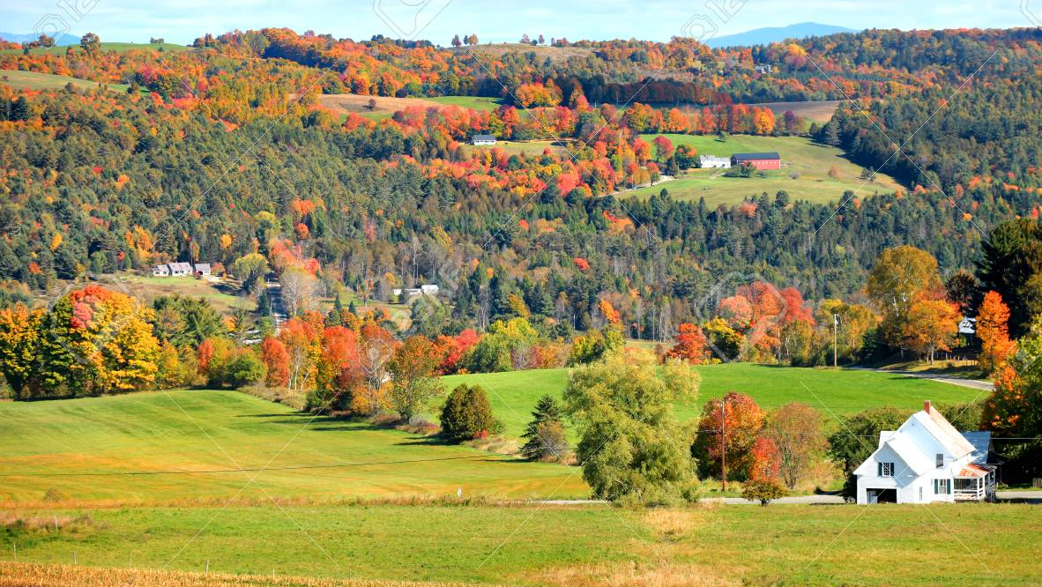
Why EcoCiv Has a Project on Rethinking Urban-Rural Relations
Urban-rural relations cuts to the core of how we live and how our communities are structured, shedding light on faulty paradigms and the complex intersectionality of our challenges. Solving systemic issues requires cooperation across sectors around a shared vision. This is what we’re here to do today.
Bridging the urban-rural divide involves bioregional approaches on a large enough scale to make a significant impact but with a contextual lens tailored to each community’s unique needs; solutions that are long-term enough make a lasting difference, but short-term enough to represent concrete actions in the present. This is the EcoCiv sweet spot.

Slide 7
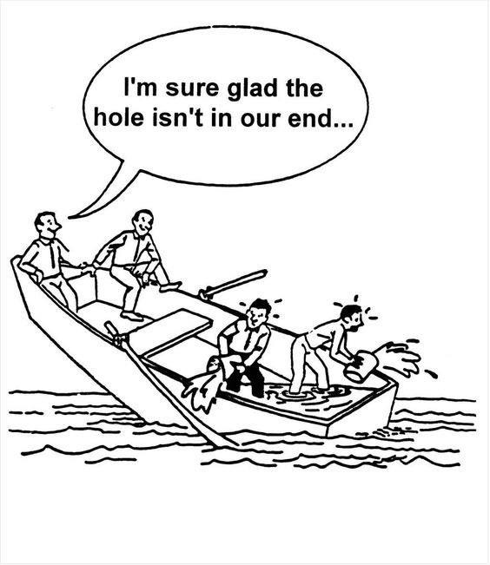
EcoCiv’s View on Communities of Communities
Strong local communities are the cornerstone of an ecological civilization. But we cannot focus on the hyperlocal to the exclusion of the national or global. Every community is related to (not isolated from) other communities, which together can form a larger community (of communities).
The rural is not isolated from the urban, nor the urban insulated from the rural. It’s not a matter of red state and blue state interests. Maintaining healthy rural communities as well as sustainable urban areas depends on the relation between the two.

Slide 8
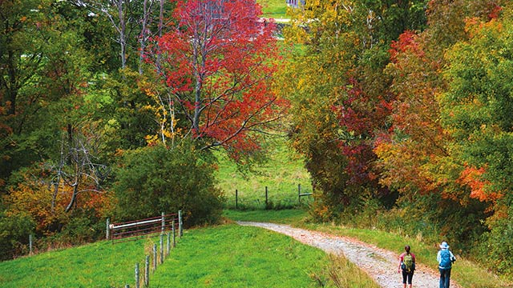
Why EcoCiv is in Vermont?
Today’s event is part of a multi-year project by EcoCiv on Rethinking the Urban-Rural Relationship. Often urban/rural discussions prioritize big city centers. We’re also working with the City of Seoul, the City of Cape Town, Los Angeles County, and the State of Oregon. However, as one of the most rural states in our country, Vermont is already leading the way on rural development, community planning, sustainable energy, etc. This is the ideal place for an urban-rural project that privileges rural life as most fundamental.
We are indebted Bill McKibben (whose two keynote lectures in Claremont inspired us to start EcoCiv) for recommending we contact John Elder—a longtime leader in environmental discourse in Vermont.

Slide 9
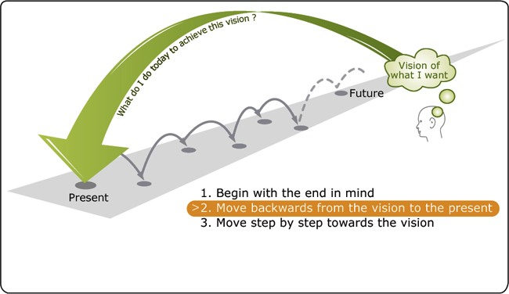
Our Method: Visioning, Backcasting, Roadmapping
Inspired by design thinking, our method employs the following:
Begin with the vision. Where do we need to be in 50 to 100 years? (70%)
Consider where we are today. What are the underlying causes of our crisis? (10%)
Chart a path forward. What are the kinds of systems and structures do we need in order to move toward that vision of a sustainable and just future? (20%)
This is what we’ll be doing today as we envision Vermont 2050!

